Slide 1

Seven Man Mechanics
Ben Metcalf, Instructor
Dallas Football Officials Association

Slide 2
Why use Seven Officials?
A crew of 7 will provide more consistent area coverage
Better detection of infractions and enforcement of rules
Better sideline control
Preventative officiating is improved
Improved coverage on the back side of a play
Dead ball officiating improved
Easier ball mechanics on deep pass plays and punt coverage

Slide 3
Pre-Game Responsibilities
**All officials adhere to standard 5 Man Mechanics
S/B: Instruct clock operators minimum 60 min before kick. S has clock duties if there is no on-field clock
S/F:
Monitor teams and maintain buffer area
Accompany and assist H/L with directions for chain crew
Accompany and assist with instructions for ball boys
Bring captains to 50 on their team sideline four min before kickoff.

Slide 4
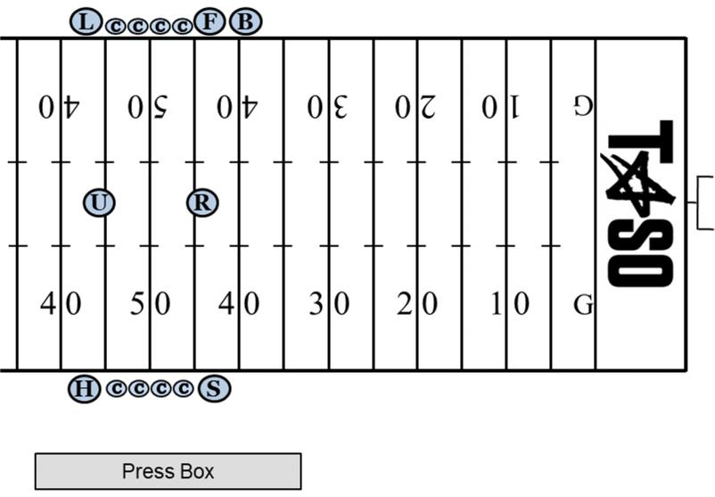
Coin toss

Slide 5
Coin Toss
SF
Escort captains to 9yd marks and stop while sending them to middle of field with R/U
Do not allow team members who are not involved in the toss inside the 9yd marks on your side
H/L/B:
Remain on the sideline. H/B have a game ball from your sideline ready until winner of toss is determined
S/F is responsible for securing 2nd half option from coach on appropriate sideline

Slide 6
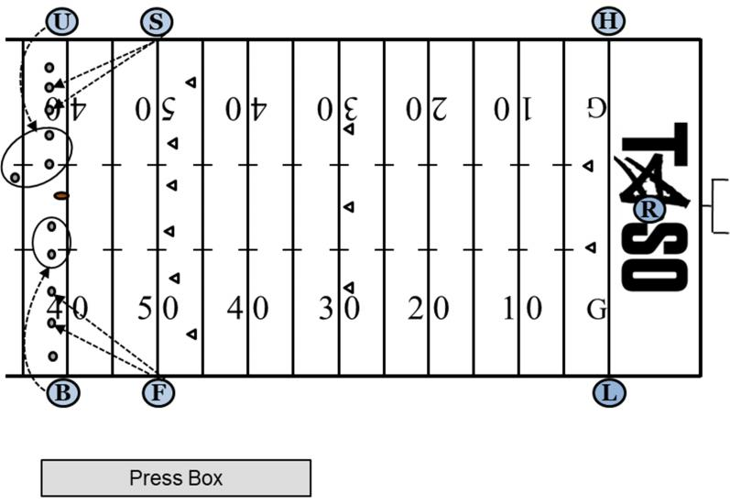
Free Kick: Keys

Slide 7
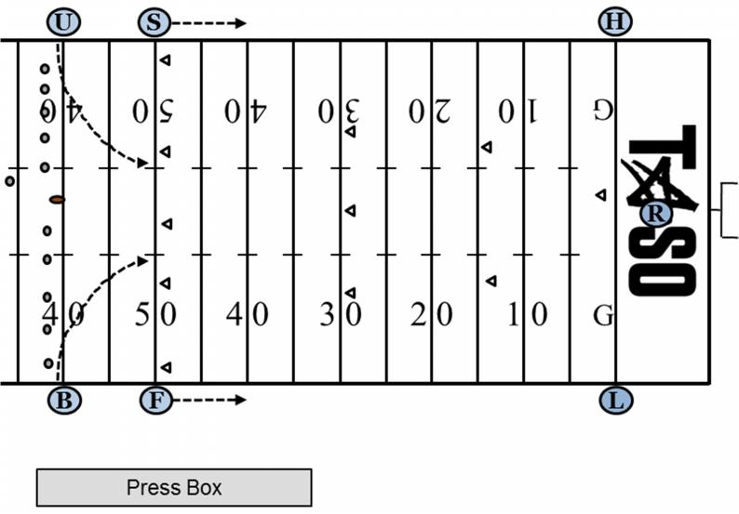
Free Kick:
Movement

Slide 8
Free Kicks: H/L
Count Receiving Team players and signal to H/L/R
Responsible for Goal Line and pylon in your zone
Watch for holding, blocks below waist, illegal wedge, blindside block
Observe area in front of runner or clean-up behind the play
Responsible for forward progress until handing it off to F/S at the A2

Slide 9
Free Kicks: F/S
Count Team A players and signal to U/B/F/S
Responsible for Team B restraining line. Watch for:
  Encroachment by Team B
  First touching by Team A
  Kick-Catch interference by Team A
  Fair catch signals on pooch kicks and deeper kicks short of the L/H
Be alert for short free kicks and balls kicked immediately into ground
Move downfield and maintain cushion – you may have to reverse field
  You have responsibility from A2 to Team A goal line
Clean up area and retrieve old/bring in new ball for your sideline

Slide 10
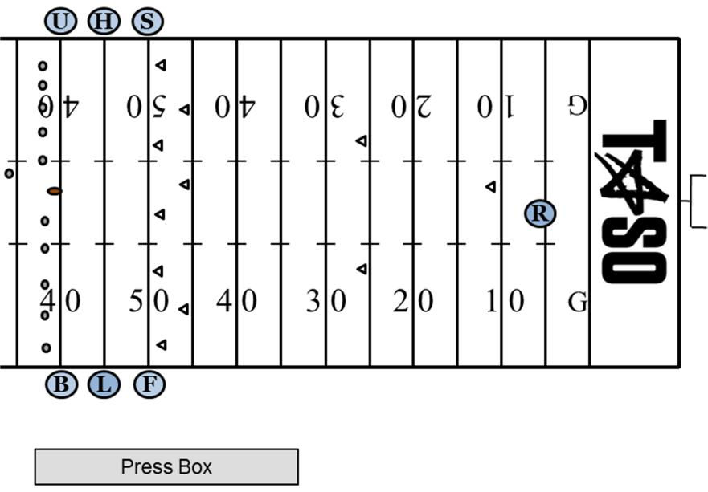
Short Kick

Slide 11
Short Kick
All: Be alert for legal/illegal touching, early blocks, fair catch, KCI
H/L watch for ball kicked immediately into ground
H/S and L/F Mechanics are reversed:
  S/F have Team B goal line (if kicked deep), forward progress (up to the A2) and dead ball spot.
  H/L have A2 to Team A goal line

Slide 12
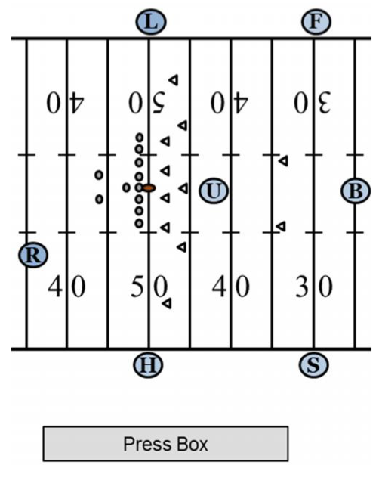
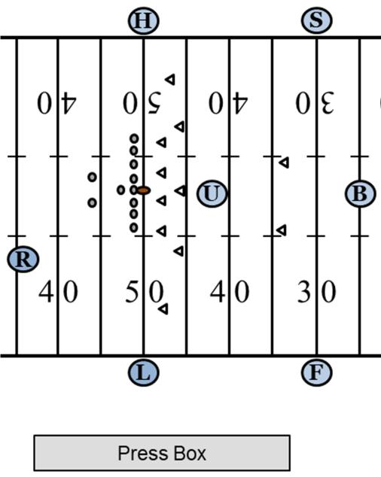
Scrimmage Plays
First half
Second Half

Slide 13
Scrimmage Plays: H/L
Except for the addition of a key receiver, responsibilities are unchanged from 5 man mechanics.
Remain on LOS until ball crosses, then officiate normally
20 yd separation should be maintained by S/F to keep play boxed in
Responsible for all forward progress, oob spots, until the B2 yd line
  If play is snapped behind B7 and goes inside 2yd line, S/F has spot and will signal TD, etc. You veer several yds behind S/F and let them officiate. Do not run into them!
If ball is snapped on or inside B7, you now have goal line (S/F position on end line)

Slide 14
Scrimmage Plays: S/F
Position 20 yds beyond LOS, out of bounds, on the sideline. If ball is snapped between B25 and B7, position on goal line. If snapped between B7 and goal line, position on endline
Count Team B. Give closed fist signal to B
Know your keys, based on the formation
S: Remember – you are always responsible for time and status of clock

Slide 15
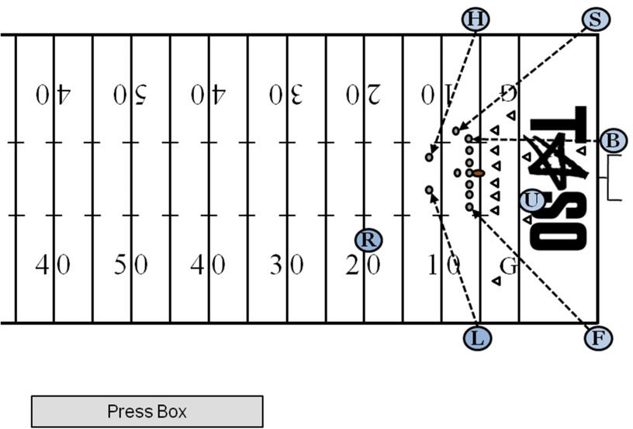
Scrimmage play snapped inside B7

Slide 16
Running Plays: S/F Man/Zone/Ball
“MAN” - Before the snap, identify and read your key(s) and note initial actions on and by key(s)
“ZONE” - After the snap, officiate player action in your zone
“BALL” - When direction of ball has been established (pass or run), officiate at and around the ball if in your zone; otherwise, back side officiating. When the ball is dead, continue to officiate your zone (dead ball officiating)

Slide 17
Passing plays: Basic Keys
F/S will always watch widest eligible receiver in the formation on your side of the field
B will watch the most inside eligible receiver on the strong side of the field. If balanced formation, ”strong side” is to the Line Judge side. If lined up in quads, B has 2 most inside receivers.
H/L will watch the eligible receiver remaining on their side

Slide 18
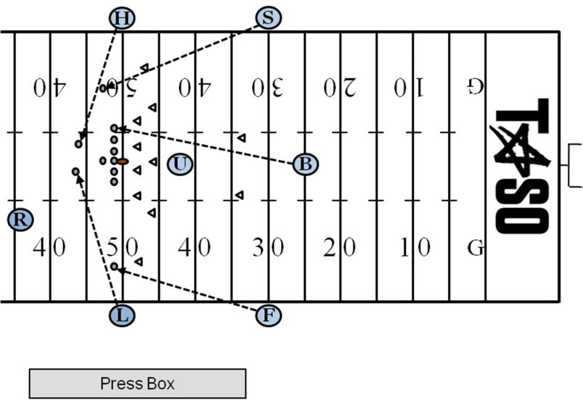
Balanced w/ TE

Slide 19
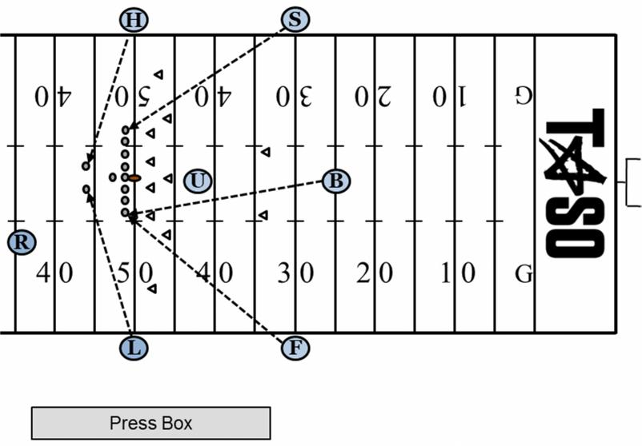
Balanced w/ double TE

Slide 20
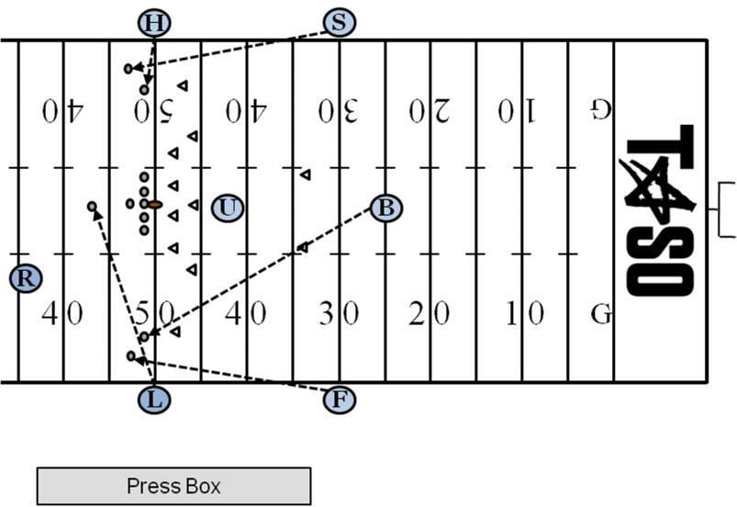
Double Wing

Slide 21
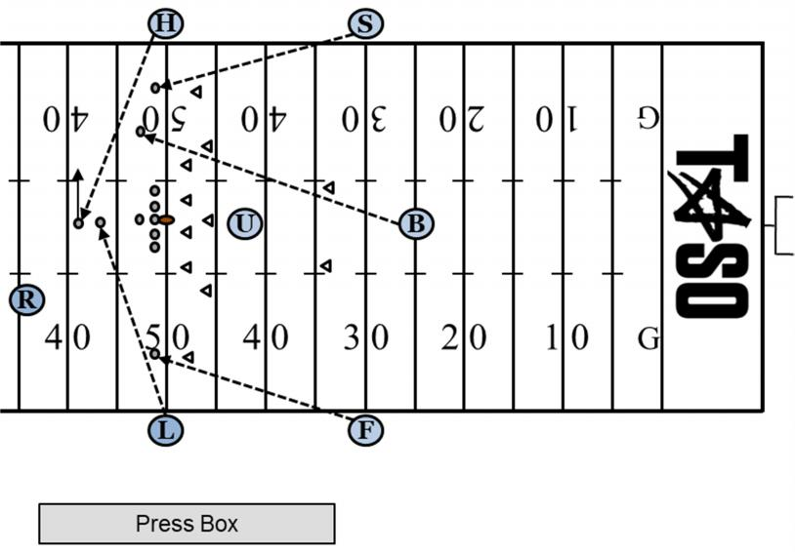
Man in motion at snap

Slide 22
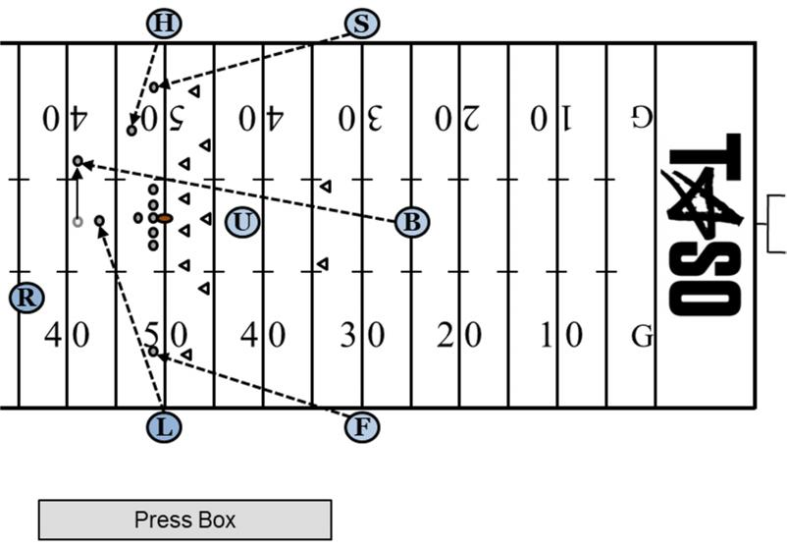
Man in motion at snap

Slide 23
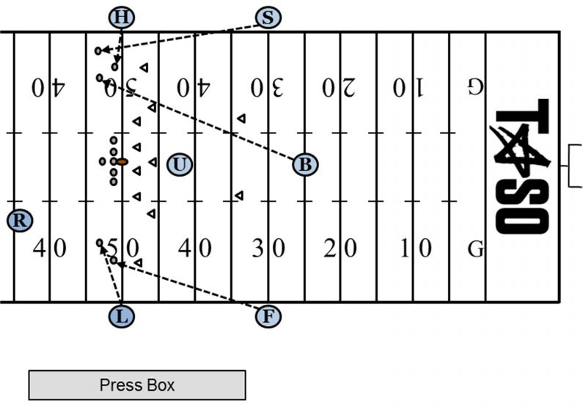
Trips

Slide 24
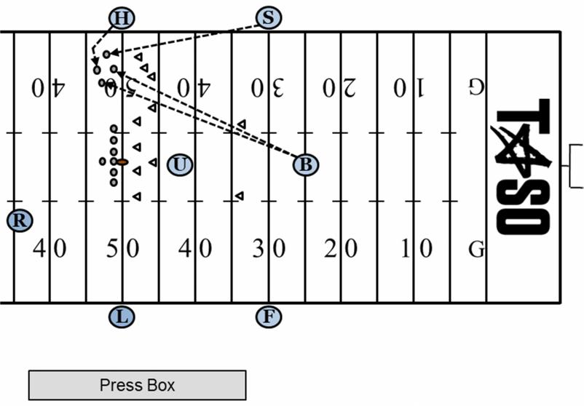
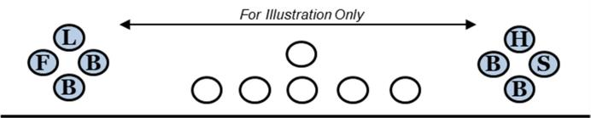
Quads:
Diamond

Slide 25

Quads:
Stacked

Slide 26
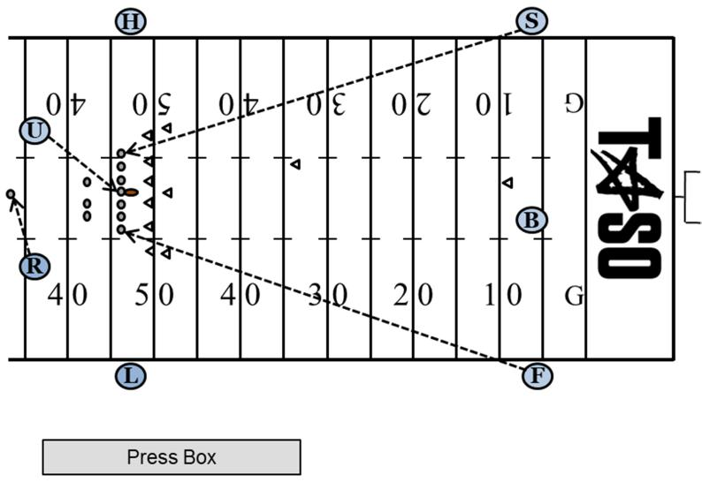
Scrimmage Kicks/Punts

Slide 27
Scrimmage Kicks/Punts: F/S
Take position on same yd line as B. If snapped inside 50, take position on goal line
Count Team B and signal to B/S/F
Help rule on valid/invalid fair catch signal, KCI, touchback, momentum
B has receiver until he turns upfield, then he becomes S/F responsibility for progress, dead ball spot, etc.
Back side official watch clean-up behind the play

Slide 28
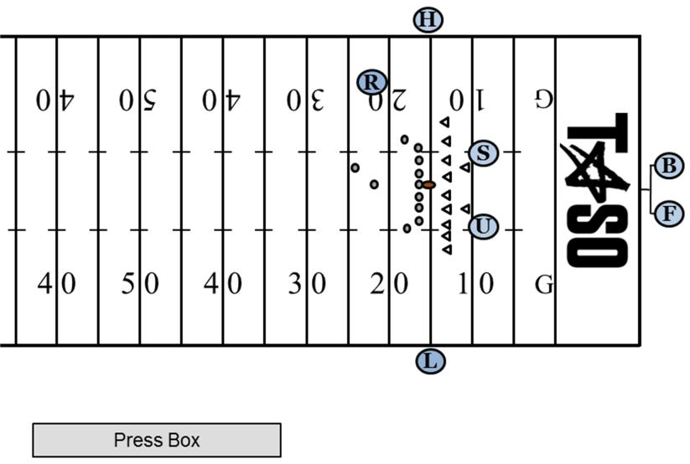
Try and Field Goal Plays

Slide 29
Try and Field Goal Plays
Field Judge
Side Judge
Positioned under upright to rule on kick
Count Team B with Back Judge
Communicate status of kick to B. Signal if kick is good or no good (to your side only)
Note eligible receivers in case of broken play. Cover end line if attempt is busted.
Positioned as a second umpire
Count Team B with R/U
Note eligible receivers
Responsible for goal line (inside out)
Move in to separate players after play

Slide 30
Measurements
R/U/H/L/B: Normal duties
Side Judge: Be near down marker and set box or chains for next series if a first down is awarded
Field Judge: Clear area of players. Assure players and officials do not block view of measurement from press box.
  If 3rd down or less – have Team A’s ball ready
  If 4th down – have both team’s balls ready

Slide 31
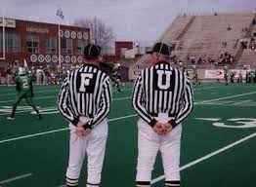
Downside to 7-Man Mechanics?

